Slide 1

Blog : Beauty Plus
TEAM 3A

Slide 2
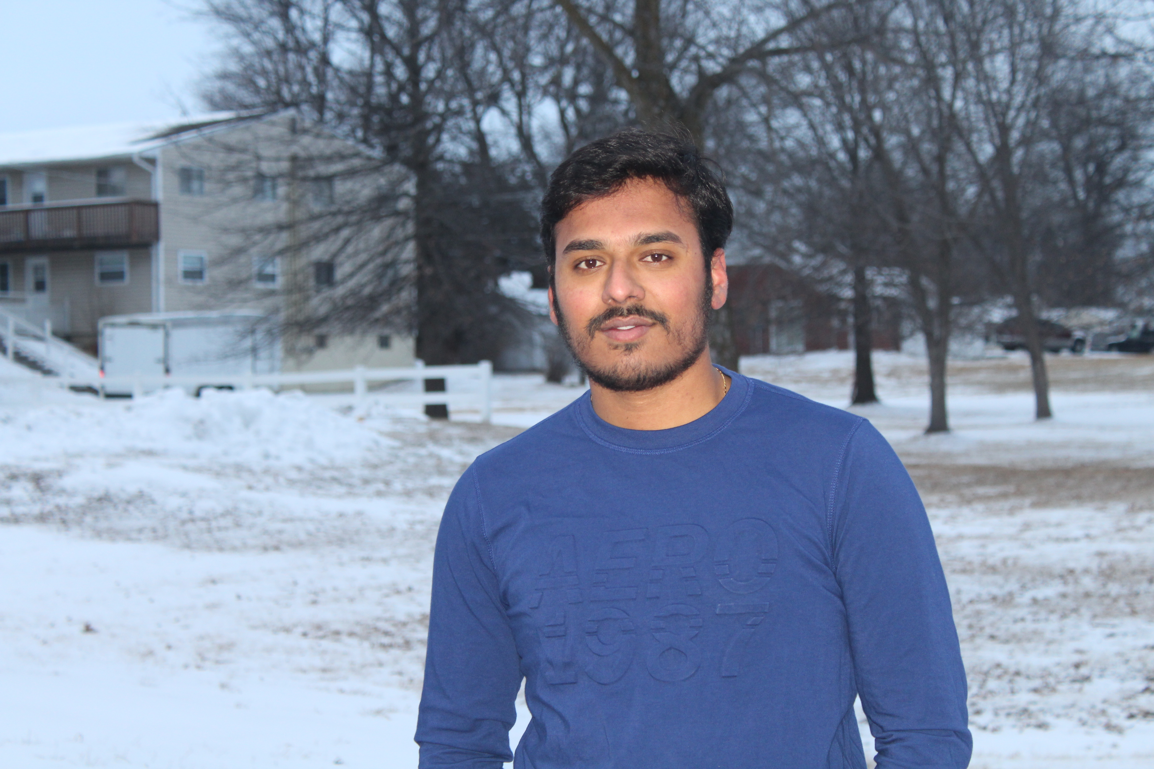
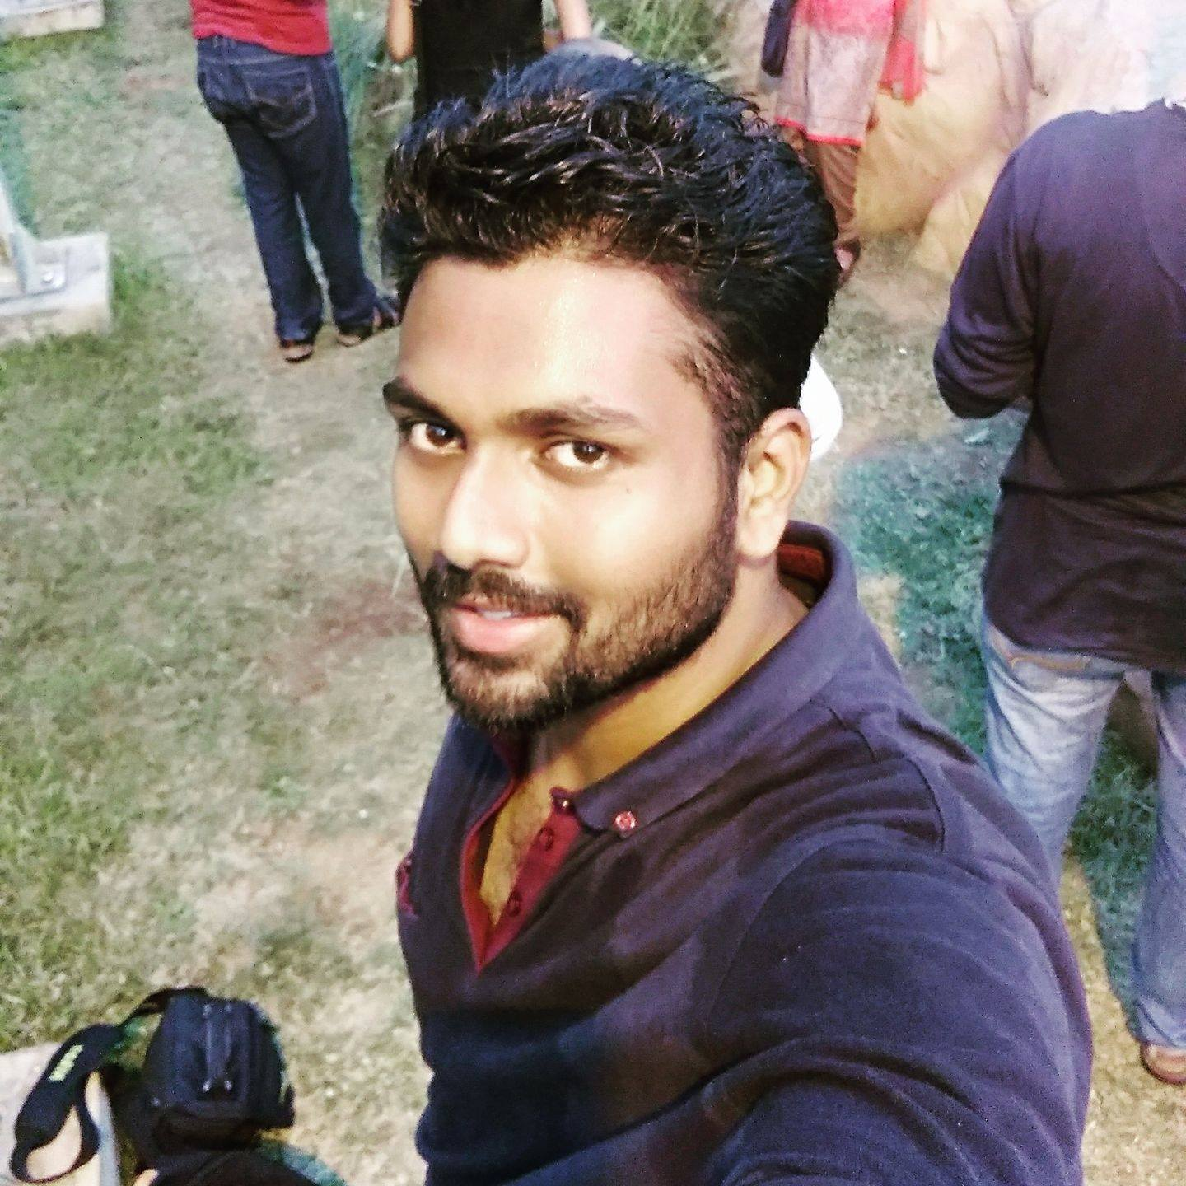
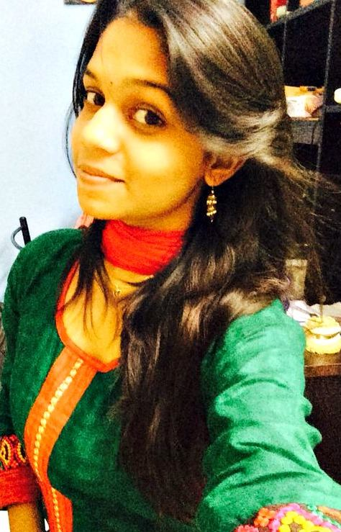
Team members
Rahul Reddy Lankala Ashok Atkuri Sai Praneetha Jaladanki

Slide 3
Contents
Introduction
Functional Requirements
ER Diagram
Tools and Technologies
Usability Logs
Demo
Member roles
Lessons Learnt
Acknowledgement

Slide 4
Introduction
A blog is a regularly updated website that is slightly different from all the other websites you see.
It can be a personal, place of interest or for a social cause
The Beauty plus blog has been designed to review and browse through different kinds of beauty products and services at one place.
The beauty blog is categorised into skin care, hair care, make-up and other beauty products.

Slide 5
User Functional requirements
Users should be able to signup
Users should be able to maintain their profile
Users should be able to review the products or the videos posted by others
Users should be able to post their opinions and pictures
Users should be able to post the tutorial makeup videos
Users should be able to make their comments

Slide 6
Admin Functional requirements
Maintain User profiles by tracking their activities
Admin should able to accept/reject any post
Admin should have a unique login id
Update the site with new information

Slide 7
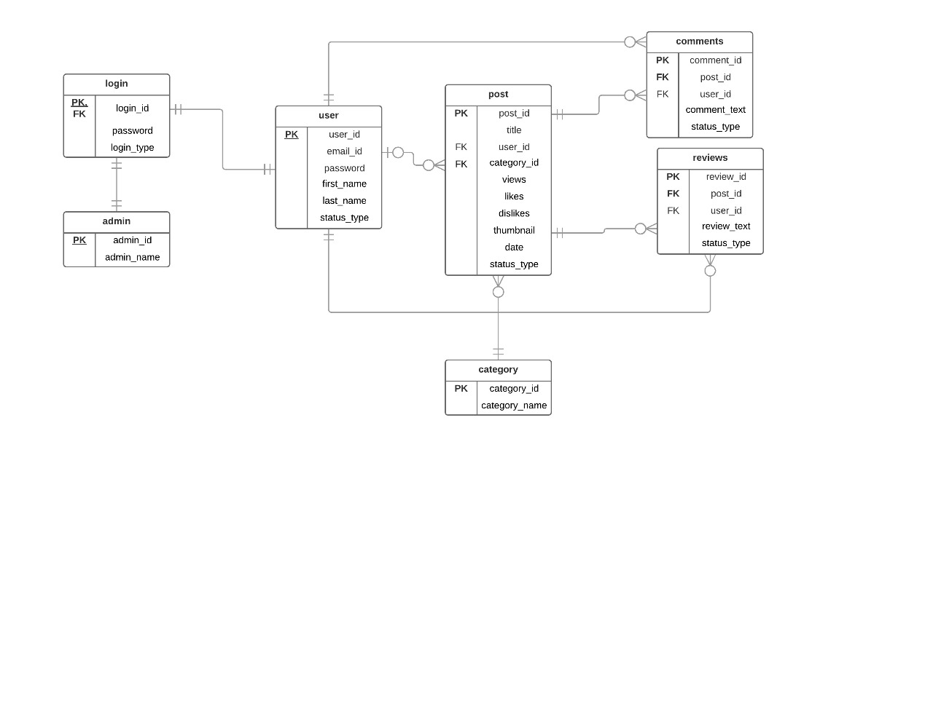
ER Diagram

Slide 8
Tools and Technologies
WordPress
XAMPP
Microsoft Word
PHP

Slide 9
Tasks
User Tasks
Information about Website
Search for Products
Sign Up
Login
Skin Care
Skin Care Admin View
Reviews
Log out

Slide 10
Tasks
Admin Tasks
Admin User List
Admin User Posts List
User Post
Admin Track Activities

Slide 11
Usability Logs: Expert User
Task | Start time(hh:mm:ss) | End time(hh:mm:ss) | No of mouse clicks | No of key strokes | No of errors | Defects/comments
T1 | 11:32:01 | 11:33:01 | 4 | 68 | 0 | User successfully registered into website.
T2 | 11:33:03 | 11:33:15 | 1 | 0 | 0 | User successfully logged into website.
T3 | 11:33:19 | 11:33:25 | 1 | 0 | 0 | N/A
T4 | 11:33:28 | 11:33:38 | 1 | 0 | 0 | N/A
T5 | 11:33:41 | 11:33:55 | 1 | 0 | 0 | N/A
T6 | 11:33:57 | 11:34:25 | 2 | 25 | 2 | Confusion in finding the link to add tutorial
T7 | 11:34:28 | 11:34:45 | 1 | 0 | 0 | N/A
T8 | 11:34:48 | 11:36:04 | 2 | 22 | 1 | Confusion in reading and writing reviews
T9 | 11:36:07 | 11:36:30 | 1 | 0 | 0 | N/A
T10 | 11:36:34 | 11:36:45 | 1 | 0 | 0 | N/A
T11 | 11:36:49 | 11:37:06 | 2 | 0 | 0 | N/A
T12 | 11:37:09 | 11:37:15 | 1 | 0 | 0 | User successfully logged out of the website

Slide 12
Novice User
Task | Start time (hh:mm:ss) | End time (hh:mm:ss) | No of mouse clicks | No of key strokes | No of errors | Defects/comments
T1 | 11:45:01 | 11:45:57 | 4 | 68 | 0 | N/A
T2 | 11:46:03 | 11:46:17 | 1 | 0 | 0 | N/A
T3 | 11:33:19 | 11:33:25 | 1 | 0 | 0 | N/A
T4 | 11:33:28 | 11:34:40 | 1 | 0 | 2 | Confusion in adding tutorial
T5 | 11:34:41 | 11:34:56 | 1 | 0 | 0 | N/A
T6 | 11:34:57 | 11:35:00 | 1 | 0 | 0 | Logged out as user
T7 | 11:35:05 | 11:35:17 | 1 | 0 | 0 | N/A
T8 | 11:35:20 | 11:36:06 | 5 | 45 | 0 | Logged in as Admin
T9 | 11:36:07 | 11:36:32 | 1 | 0 | 1 | Managing site content
T10 | 11:36:34 | 11:36:47 | 1 | 0 | 0 | N/A
T11 | 11:36:49 | 11:37:28 | 5 | 0 | 3 | Managing user posted content. Little confusion in finding user and their relevant info
T12 | 11:37:30 | 11:37:33 | 1 | 0 | 0 | Admin successfully logged out of the website

Slide 13
Defects List
S. No. | Defects | User1 | User2
1 | Link for profile to post tutorials as per the user | Yes | No
2 | To be more clear regarding the admin functionalities as per the view. | No | Yes
3 | In the page for tutorial, a preview was not supplied | No | No

Slide 14

Demo

Slide 15
Member roles
Testing Location: | Student Union Meeting room
Test Users: | Students in the university
Facilitator: | Sai Praneetha Jaladanki
Human Computer: | Rahul Reddy Lankala
Log Keeper: | Ashok Atkuri
Video Recorder: | Ashok Atkuri, Rahul Reddy Lankala

Slide 16
Lessons Learnt
Importance of application design.
Prototyping.
Team work
How to tackle different types of users
Importance of User interface.
Time management.

Slide 17
Acknowledgement
We would like Thank Dr. Charitha Hettiarachchi for assisting us in developing the knowledge related to our Human Computer Interaction course.
We would also like to thank our GA, Haritha Arikapudi for helping us whenever we had a question or two regarding the subject.

Slide 18
Thank You!

Slide 19
Any Questions?

